Slide 1
HYPERTHERMIA (HEAT STROKE OR HEAT EXHAUSTION)& Fever
By
Dr. Hussein ALNaji

Slide 2

Hyperthermia is the elevation of core body temperature caused by excessive heat production or absorption, or to deficient heat loss, when the causes of these abnormalities are purely physical. Heat stroke (heat exhaustion) is the most commonly encountered clinical entity.
ETIOLOGY The major causes of hyperthermia are the physical ones of high environmental temperature and prolonged, severe muscular exertion, especially when the humidity is high, the animals are fat, have a heavy hair coat, or are confined with inadequate ventilation such as on board ship or during road transportation.

Slide 3

Other Causes of Hyperthermia
Neurogenic hyperthermia: Damage to hypothalamus, e.g., spontaneous hemorrhage, may cause hyperthermia
Dehydration: Caused by insufficient tissue fluids to accommodate heat loss by evaporation
Excessive muscular activity: For example, strychnine poisoning
Miscellaneous poisonings, including levamisole and dinitrophenols
Malignant hyperthermia in Quarter Horses.
Hyperkalemic periodic paresis in horses.
Administration of tranquilizing drugs to sheep in hot weather.

Slide 4
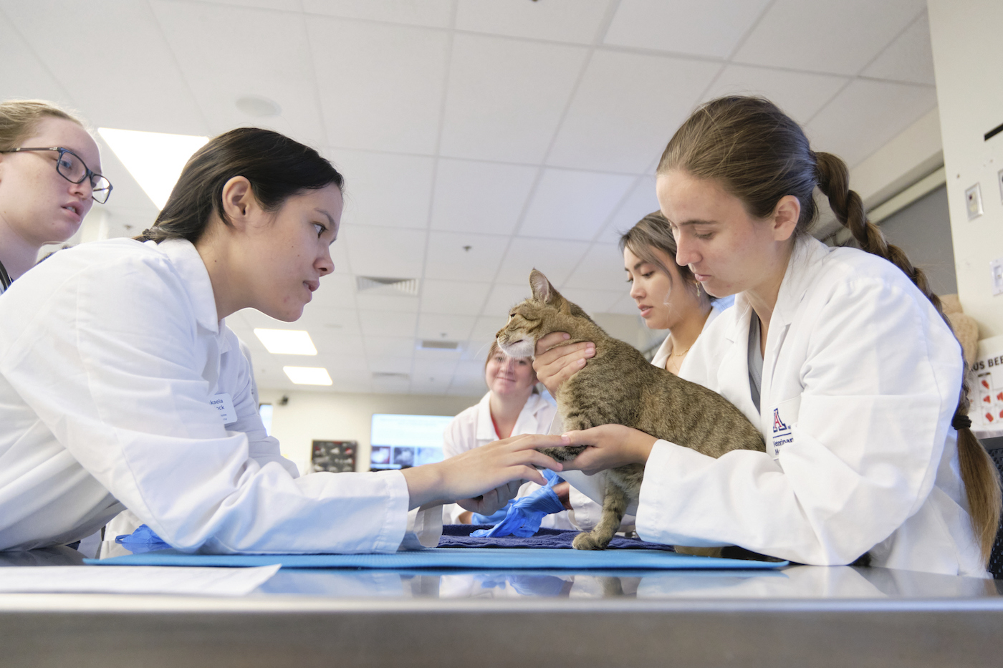
CLINICAL FINDINGS
An elevation of body temperature is the primary requisite for a diagnosis of hyperthermia, when the rectal temperature is increased by 3 to 4°C (4–7°F) above normal.
An increase in heart and respiratory rates with a weak pulse of large amplitude, sweating, and salivation occur initially, followed by a marked absence of sweating.
The animal may be restless but soon becomes dull, stumbles while walking, and tends to lie down.
In the early stages there is increased thirst and the animal seeks cool places, often lying in water or attempting to splash itself.
Abortion may occur if the period of hyperthermia is prolonged, and a high incidence of embryonic mortality has been recorded in sheep that were 3 to 6 weeks pregnant.

Slide 5
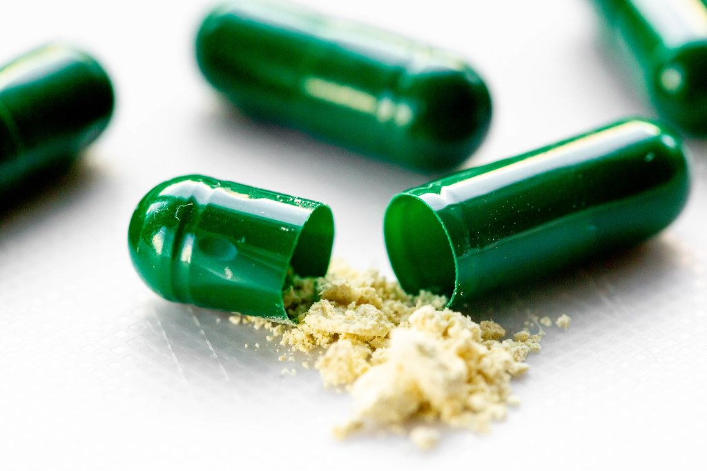
TREATMENT The presence of adequate drinking water is essential and, together with shade and air movement, is of considerable assistance when multiple animals are exposed to high air temperature.
This Photo by Unknown Author is licensed under CC BY

Slide 6
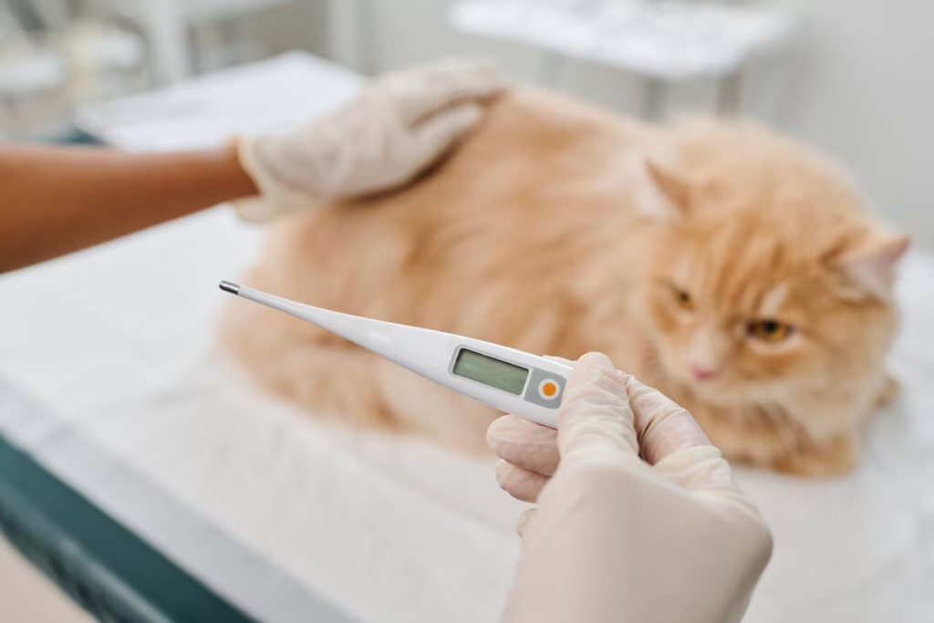
FEVER (PYREXIA)
Fever is an elevation of core body temperature above that normally maintained by an animal and is independent of the effects of ambient conditions on body temperature.
It is important to realize that fever is a combination of hyperthermia and infection or inflammation that results from an elevated set point for temperature regulation.
ETIOLOGY Fevers may be septic, the more common type, or aseptic, depending on whether or not infection is present.

Slide 7
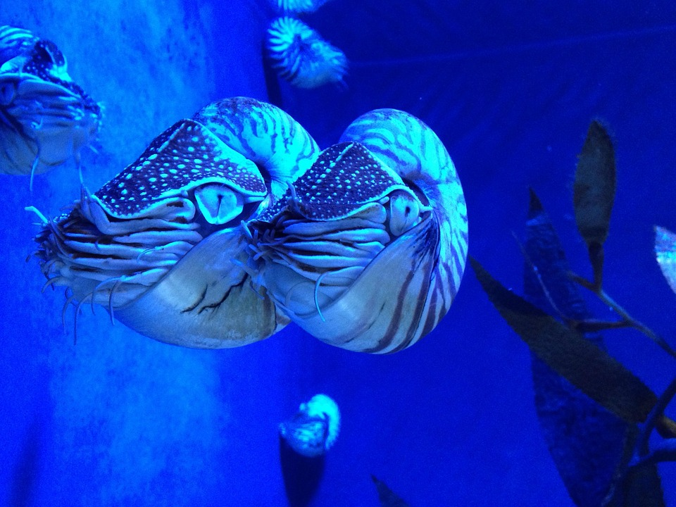
A- Septic Fevers
These include infection with bacteria, viruses, protozoa, or fungi as
Localized infection such as abscess, cellulitis, and empyema.
Intermittently systemic, as in bacteremia and endocarditis
Consistently systemic, as in septicemia.

Slide 8

B- Aseptic Fevers
Chemical fevers, caused by injection of foreign protein and intake of dinitrophenols.
Surgical fever, caused by breakdown of tissue and blood
Fever from tissue necrosis, e.g., breakdown of muscle after injection of necrotizing material
Severe hemolytic crises (hemoglobinemia).
Extensive infarction
Extensive necrosis in rapidly growing neoplasms such as multicentric lymphosarcoma in cattle
Immune reactions such as anaphylaxis and angioneurotic edem

Slide 9
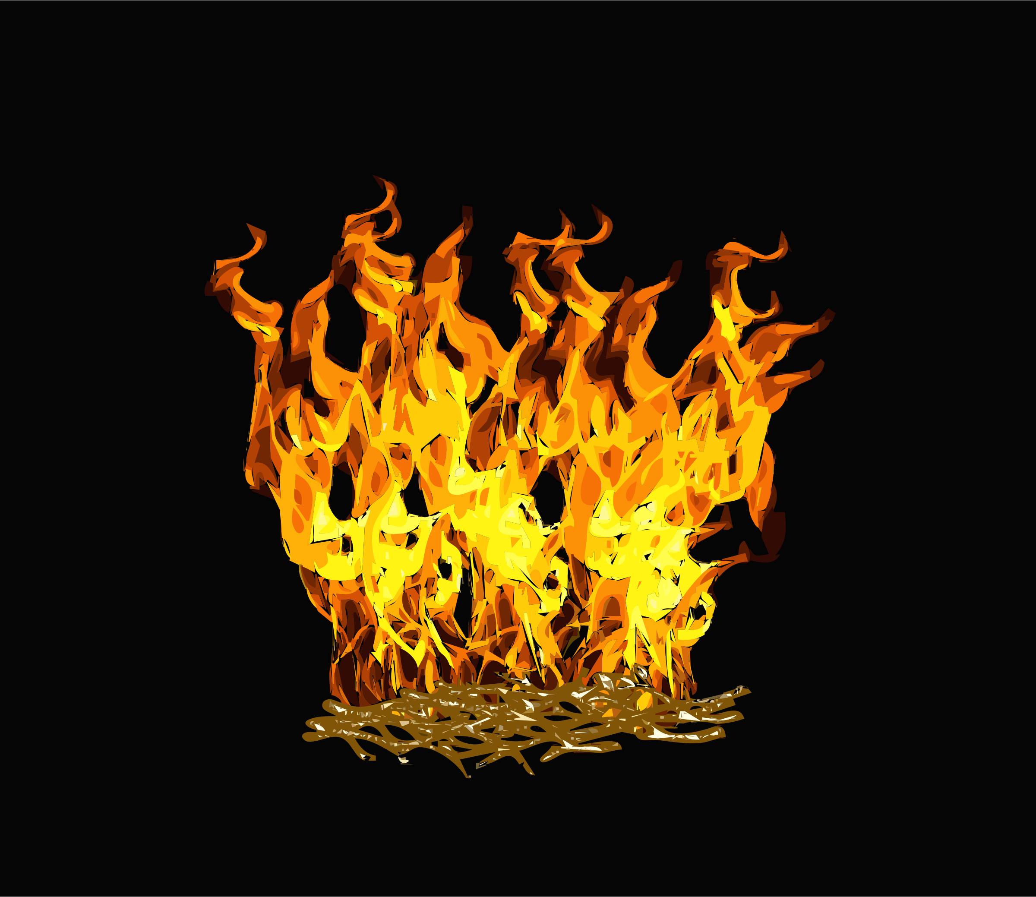
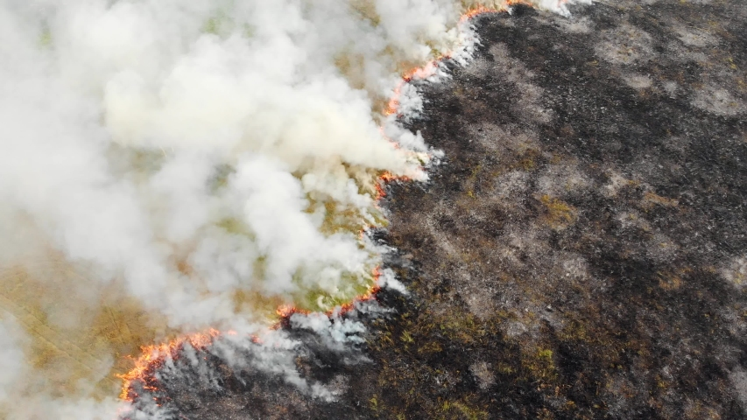
Pathogenesis
The fever are mediated through the action of endogenous pyrogen as a response is initiated by the introduction of an exogenous pyrogen into the body.
Endogenous pyrogens are proteins consist of (monokines and lymphokines) both called cytokines Releasd from monocyte and lymphocyte. One of the pyrogenic cytokines is Interleukin -1
Interleukin-1 initiates fever by inducing an abrupt increase in the synthesis of prostaglandins, in the anterior hypothalamus
raise the thermostatic set point and induce the mechanisms of heat conservation (vasoconstriction) and heat production (shivering thermogenesis)
The blood and core temperature are elevated to match the hypothalamic set point

Slide 10

CLINICAL FINDINGS
The effects of fever are the combined effects of hyperthermia and infection or inflammation.
There is elevation of body temperature, an increase in heart rate with a diminution of amplitude and strength of the arterial pulse.
hyperpnea, wasting, oliguria often with albuminuria.
increased thirst, anorexia, scant feces, depression, and muscle weakness.

Slide 11

CLINICAL PATHOLOGY
The most common tests include the following: • Microbiologic testing of blood samples • Analysis of serous fluids from body cavities • Cerebrospinal fluid analysis • Milk sample analysis • Reproductive tract secretion analysis • Joint fluid analysis • Biopsies • Exploratory laparotomy Medical imaging may be necessary to detect deep abscesses

Slide 12
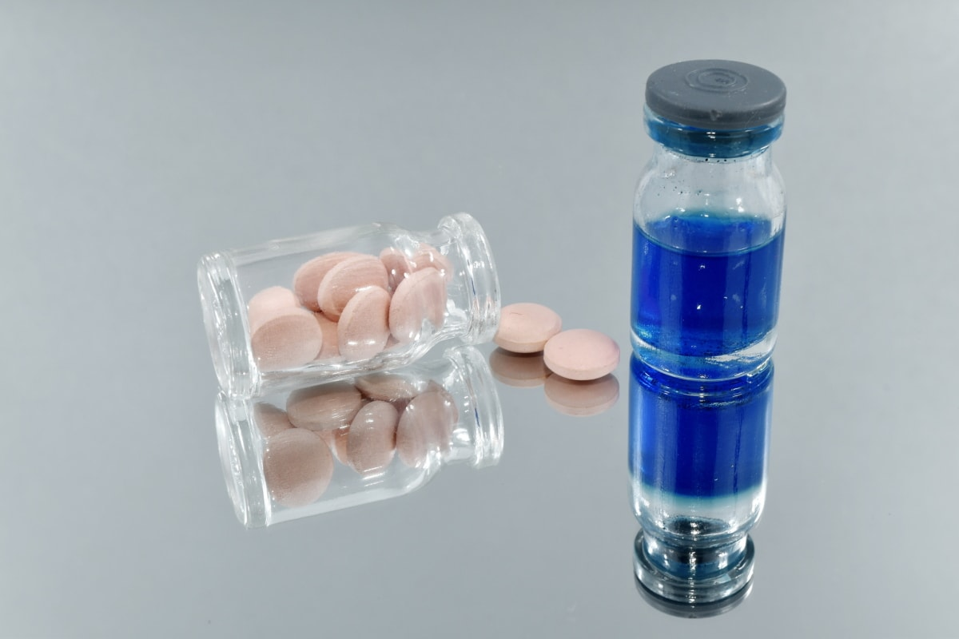
TREATMENT 1- Antimicrobial Agents 2- Antipyretics such nonsteroidal antiinflammatory drugs (NSAIDs) should be administered. Most NSAIDs, such as flunixin meglumine, are inhibitors of prostaglandin synthesis and act centrally to lower the thermoregulatory set point.

Slide 13

Sepsis
Sepsis is a suspected or proven bacterial infection in conjunction with the presence of systemic inflammatory response syndrome (SIRS), which is defined as systemic inflammation in response to injury, being caused by infectious agents (e.g., bacteria, viruses, protozoa, fungi) or by noninfectious causes (e.g., trauma, toxins, hyperthermia, burns).
Accurate criteria for SIRS have yet to be identified in domestic animals, but the presence of at least two of the following abnormalities is used to identify the presence of SIRS in humans: A- Hyperthermia or hypothermia b- Tachycardia c-Tachypnea or hyperventilation
D- Leukopenia, leukocytosis, or >10% band neutrophils

Slide 14

1-Severe sepsis is sepsis accompanied by organ dysfunction.
2- Septic shock is defined as severe sepsis with hypotension (mean arterial blood pressure.
3- Septic shock is defined as severe sepsis with hypotension (mean arterial blood pressure <65 mm Hg) despite aggressive intravenous fluid therapy.
4- Septicemia is the acute invasion of the systemic circulation by pathogenic bacteria accompanied by septic shock with possible bacterial localization in various body systems or organs. It is a common cause of morbidity and mortality in newborn farm animals that have not received a sufficient quantity of colostrum in the first 24 hours after birth.

Slide 15

Bacteremia is different from septicemia in that bacteremia is not accompanied by sepsis or septic shock. The difference between septicemia and bacteremia is one of degree.
In bacteremia, bacteria are present in the bloodstream for only transitory periods and do not produce clinical signs; for example, a clinically unimportant bacteremia probably occurs frequently after rectal examination or other manipulations in which the mucosa is disturbed.
In septicemia, the pathogen is present throughout the course of the disease and is directly responsible for initiation of the disease process.
Viremia is the invasion of the systemic circulation by pathogenic viruses with localization in various body tissues and in which the lesions produced are characteristic of the specific virus.

Slide 16

Toxemia is a clinical systemic state caused by widespread activation of host defense mechanisms to the presence of toxins produced by bacteria or injury to tissue cells. Toxemia does not include the diseases caused by toxic substances produced by plants or insects or ingested organic or inorganic poisons.
The most common form of toxemia in large animals is endotoxemia, caused by the presence of lipopolysaccharide cell-wall components of gram-negative bacteria in the blood and characterized clinically by abnormalities of many body systems.

Slide 17

ETIOLOGY
Toxins can be classified as antigenic or metabolic.
A- Antigenic Toxins
These are produced by bacteria and to a lesser extent by helminths. Both groups of pathogens act as antigens and stimulate the development of antibodies. Antigenic toxins are divided into exotoxins and endotoxins.
1- Exotoxins
These are protein substances produced by bacteria that diffuse into the surrounding medium. They are specific in their pharmacologic effects and in the antibodies that they induce. The important bacterial exotoxins are those produced by Clostridium spp.

Slide 18

2- Enterotoxins
These are exotoxins that exert their effect principally on the mucosa of the intestine, causing disturbances of fluid and electrolyte balance. The most typical example is the enterotoxin released by enterotoxigenic E. coli, which causes a hypersecretory diarrhea in neonatal farm animals.
3- Endotoxins
The endotoxins of several species of gram negative bacteria are a major cause of mor bidity and mortality in farm animals. The endotoxins are lipopolysaccharides found in the outer wall of the bacteria.

Slide 19

B- Metabolic Toxins
These may accumulate as a result of incomplete elimination of toxic materials normally produced by body metabolism, or by abnormal metabolism. Normally, toxic products produced in the alimentary tract or tissues are excreted in the urine and feces or detoxified in the plasma and liver. When these normal mechanisms are disrupted, particularly in hepatic dysfunction, the toxins may accumulate beyond a critical point and the syndrome of toxemia appears.

Slide 20

Hypovolemic, Hemorrhagic, Maldistributive, and Obstructive Shock
ETIOLOGY
The circulatory system consists of a pump (the heart) and a circuit (the vasculature).
Circulatory shock can result from abnormal functioning of the pump or circuit, or both.
It is clinically very important to differentiate pump failure (cardiogenic shock caused by acute or chronic heart failure) from circuit failure, because the diagnosis and treatment of cardiogenic shock is vastly different from that of circuit shock.

Slide 21

Circuit failure occurs whenever the cardiac output is reduced below a critical point because of inadequate venous return to the heart. There are four main ways that circuit failure occurs:
Hypovolemic shock occurs when there is a reduction in circulating blood volume caused by loss of blood, plasma, or free water.
Hemorrhagic shock occurs when there is a reduction in circulating blood volume caused by the rapid loss of blood.

Slide 22

3. Maldistributive shock occurs when there is a reduction in circulating blood volume caused by increased capillary permeability, pooling of blood in capacitance vessels (such as the veins in the splanchnic circulation), or pooling of plasma in a large third space such as the thoracic or abdominal cavities.
4. Obstructive shock occurs when there is an acute reduction in venous return caused by a mechanical obstruction, such as pericardial tamponade or pulmonary artery thrombosis. Obstructive shock is extremely rare in large animals.

Slide 23


